Slide 1
Spaceship Titanic
Presentation by :
CHEAM Richard,
LY Sovanleng,
NOUV Ratanakmuny,
THUO Menghor
04 April 2024

Slide 2
Table of contents
Introduction
Data Analysis
Exploratory Data Analysis (EDA)
Missing Values
Correlation Analysis
Data Preprocessing
Model Selection
Feature Selection
Further Experiment
Performance on Kaggle
Conclusion

Slide 3
01
Introduction

Slide 4

Introduction
Onboard the Spaceship Titanic, 13,000 passengers ventured into the cosmos, yet the fate of 1/3 remains unknown.
Our mission: to predict their destinies using the saga of the 2/3 we've unraveled. This is our quest through time and space.

Slide 5
02
Data Analysis

Slide 6
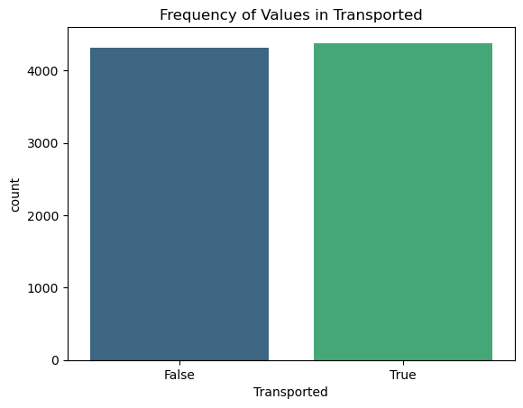
Exploratory Data Analysis (EDA)
49.6%
50.4%
13 Predictors:
PassengerID
HomePlanet
CryoSleep
Cabin
Destination
Age
VIP
RoomService,FoodCourt,ShoppingMall, Spa, VRDect
Name
1 Target variable:
Transported

Slide 7
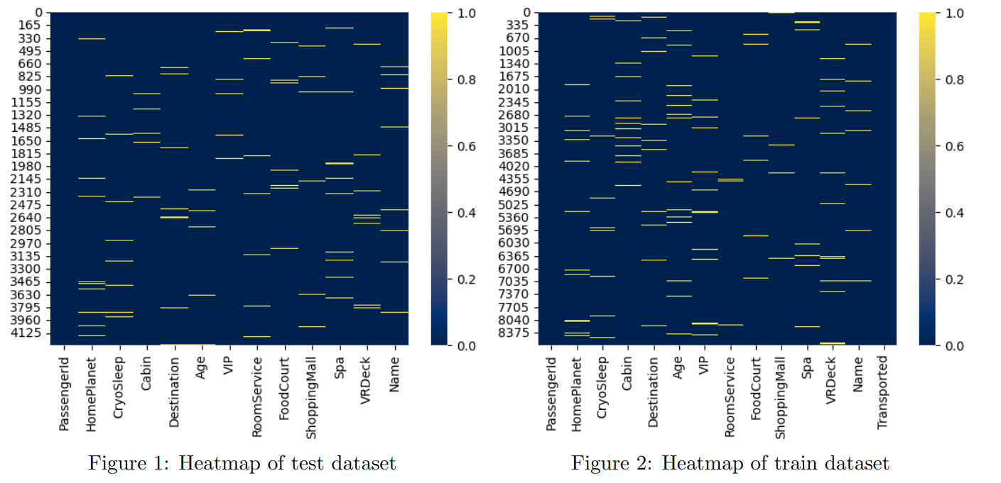
Missing Values

Slide 8
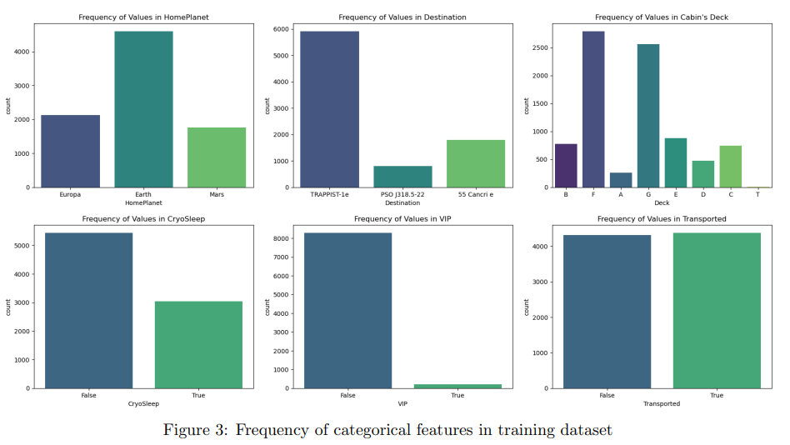
Descriptive statistics

Slide 9
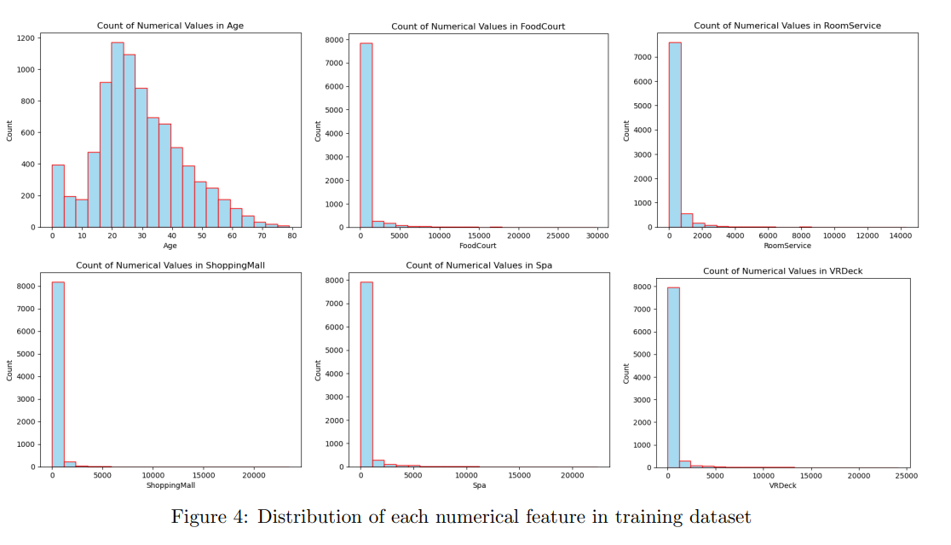

Slide 10
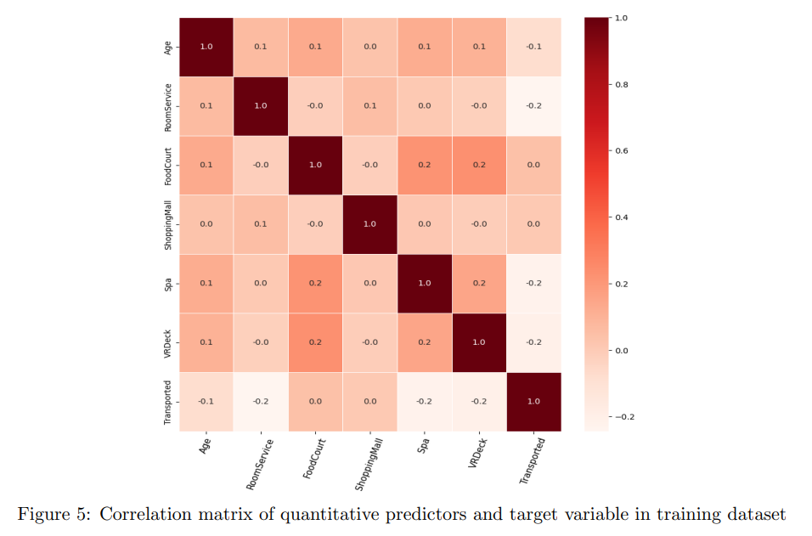
Correlation Analysis
Subtle Relationships: The data reveals mild correlations, indicating nuanced relationships between features.
Room for Complexity: No single feature strongly predicts transportation to an alternate dimension, suggesting a need for more sophisticated modeling techniques.
Spending Patterns: Passengers' spending on 'Spa' and 'VRDeck' amenities shows a pattern, hinting at linked preferences.
Predictive Hints: A slight negative correlation between 'RoomService' spending and being transported could offer a clue in predicting outcomes.
Data Strategy: Weak correlations imply the potential benefit of non-linear models and feature engineering for better predictions.

Slide 11
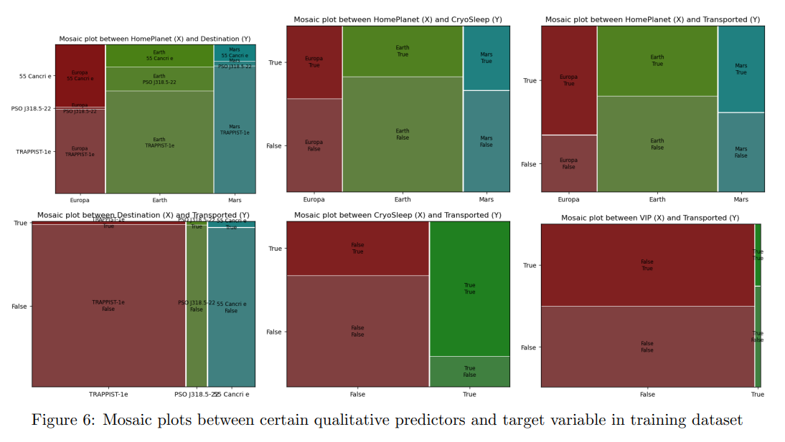

Slide 12
Data Preprocessing
There are several steps in this process including :
Feature Engineering
Data Encoding :
Label encoding
ordinal encoding
Handling Missing Values:
Numerical variable: KNNImputer
Categorical variable: SimpleImputer

Slide 13
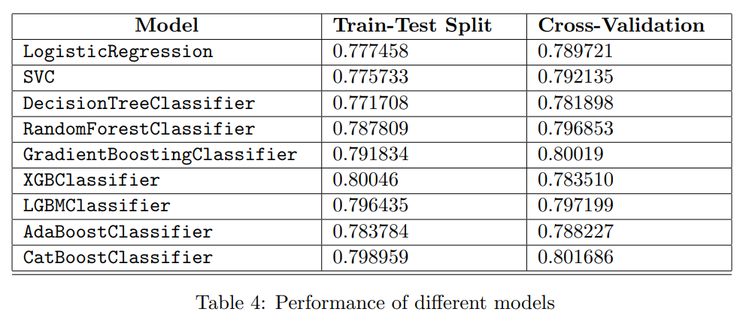
Model Selection

Slide 14
Feature Selection
Selected Model: CatBoostClassifier
Tool: Sequential Feature Selection (Step-Forward)
Selected Feature:
CryoSleep, RoomService, Spa, VRDeck, Deck, Side, and Total Expense
Submission Score in Kaggle: 81.225

Slide 15

Further Experiment
-> Majority Vote
->
OR
OR
OR

Slide 16
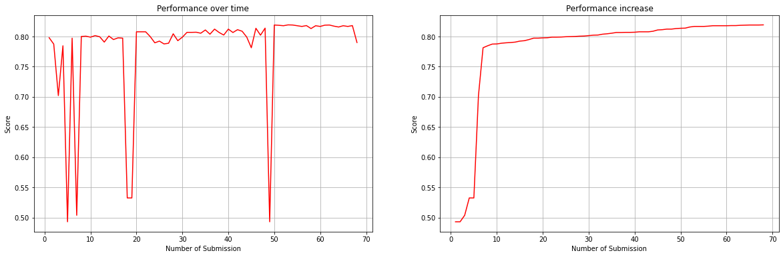
Performance on Kaggle
Rank: 45/2605 (top 2%)
Best score: 0.81926

Slide 17
Conclusion
-> Data Preparation and Methodologies used proved to be effective
-> The combination of different features engineering leaded to an improvement
-> Expanding the range of tested models and putting weights on the combination of models

Slide 18
Thank You

